Slide 1
Bacterial Genomics

Slide 2
Bacterial Genomics, Community Structure and Metagenomics
Given a sample such as soil or intestinal material, what would you like to learn about the bacterial population?
What kinds of bacteria (phyla, species)
How much is bacterial, how much other sources
Proportions of species in populations
What genes are present, individually or in population
What genes are expressed
Comparison of samples, different conditions
Interactions, host, disease and environment

Slide 3
Because bacteria are microscopic and have simple morphologies, we tend to overlook them … unless they make us sick
They have a huge impact on the environment and host organisms
Even though they are single-cell organisms, they live in close association with each other in communities and have extensive interactions with their hosts, other microbes (biofilms), and the environment
Complex systems, feedback
In the lab, we have tended to study them as single species, but that is not how they occur in nature

Slide 4
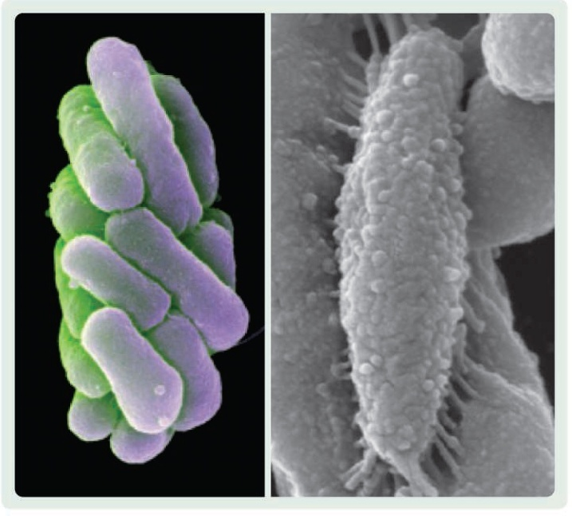
Microbial Interactions are Complex
Chlorochromatium aggregatum – composed of two bacteria: central, motile species and photosynthetic epibionts. The motile bacteria moves the group to the best environment, and the epibionts appear to feed the central bacteria fixed organic carbon (energy source). The bacteria are connected by periplasmic tubes (periplasm – space between cell membrane and cell wall).
Epibiont
Central
bacterium
Epibiont
SCIENCE VOL 324 29 MAY 2009 1150-1151

Slide 5
Big environmental impact
Bacteria are intimately involved in soil chemistry and the growth of plants
Legume symbionts, Nitrogen fixation
Chemical cycles
Prochlorococcus marina
Smallest free-living phototroph
~10⁵/ml in ocean water
Estimated to be responsible for ~25% O₂ production by photosynthesis
Zehr et al., 2017, Science 357:646

Slide 6
Evolving diseases
Triple Threat: New Pneumonia Is Drug-Resistant, Deadly And Contagious
"Doctors in Hangzhou in southeastern China have detected a a type of pneumonia that is both highly drug-resistant and very deadly. It also spreads easily. The bacterium — a type of Klebsiella pneumoniae — killed five people in an intensive care unit in Hangzhou in 2016, researchers reported Tuesday in the journal Lancet Infectious Diseases." … The microbe can fight off all drugs available in China, Chen says. "We don't have anything in China to stop it," he says. "There is a drug available in the U.S. that should be effective against it, but we haven't tested it yet."
http://www.npr.org/sections/goatsandsoda/2017/09/02/547892623/triple-threat-new-pneumonia-is-drug-resistant-deadly-and-contagious

Slide 7
High Throughput Sequencing Allowing a New Look at Bacterial Genomics
Community structure
Interactions between populations of bacterial species, the environment and other organisms – fungi, plant roots, host organisms
Bacteria in nature aren't pure cultures
Metagenomics – the total genetic potential of a community
Host-microbe interactions, the human microbiome
Involvement of bacteria in ecosystems
Geochemical processes – nitrogen cycle, phosphate cycle
Sequencing and characterization of novel un-cultured microorganisms
Novel genes and proteins
Bioprospecting - useful enzymes, bioprocesses, biochemicals

Slide 8
Why pure cultures were and are important
Allowed study of genetic regulation
Responses not confounded by other organisms
Comparison of parent strain to mutant strain
Can control and manipulate the environment
Isolation of components such as enzymes
Molecular biology/genetics grew from the study of bacteria and their viruses (bacteriophage)
Particularly Escherichia coli
Rapid grower (~30 min. doubling time in rich media)
Easily manipulated

Slide 9
Koch's Postulates
Establishing that a microorganism causes a disease
Robert Koch and Friedrich Loeffler 1884, Koch 1890
Microorganism must be found in diseased but not healthy animals (later recognized asymptomatic carriers)
Must isolate and culture the microorganism in pure form
Reintroduction of microorganism produces the same disease
Microorganism can be re-isolated from the experimentally infected animals
The gold standard for association of a microorganism and a disease
But the majority of bacteria still can't be cultured under typical lab conditions
http://en.wikipedia.org/wiki/Koch%27s_postulates

Slide 10
Bacteria are different from multicellular organisms. Does the species concept apply?
First defined by observation of characteristics – organisms
Appearance(spheres, rods, and spirals)
Growth conditions
Ernst Mayr's Biological Species Concept
Species is a maximally inclusive group whose members can produce fertile offspring
This definition doesn't apply for all animal species
But we usually know an animal species when we see one
Definition of species for bacteria still debated

Slide 11
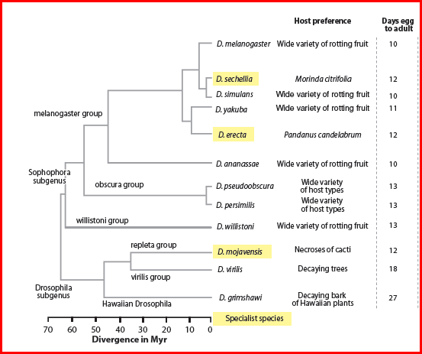
Phylogenetic tree of Drosophila species with sequenced genomes
Singh, et al., Annu. Rev. Ecol. Evol. Syst. 2009. 40:459–80
Species relationships are clear over this group of Drosophila separated by ~65 million years
A pattern of clear, lineal descent in the form of a tree

Slide 12
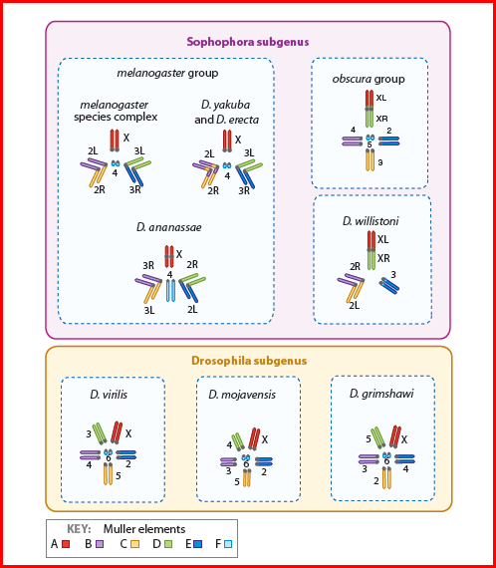
Relatedness is usually clear in eukaryotes at the level of chromosome structure, even when chromosome number varies – syntenic (homologous) segments of chromosomes
Related structure of chromosomes (synteny) is clear at the level of DNA sequence.
Singh, et al., Annu. Rev. Ecol. Evol. Syst. 2009. 40:459–80

Slide 13
Bacterial World Is Incredibly Diverse
Within species diversity is large
E. coli K12 – 4.6 Mb (common lab strain)
E. coli O157 – 5.6 Mb (pathogenic strain), closer to Shigella
Difference of ~1100 genes
Shigella (causes dysentery) now regarded by many as subgenus of E. coli
H. pylori – can cause gastric ulcers
Different strains from different geographic regions
Up to 45% of genes can be unique to a strain
Genomic re-arrangements are common
Duplications
Deletions
Inversions
Translocations
Bacteria are masters of biochemical diversity and specialization
When you're a single cell, you can't do much in the way of structural complexity

Slide 14
Most bacteria haven't been isolated and cultured
It is estimated that only 0.1-1% of the bacterial species in a soil community can be readily cultured
For aquatic environments, the estimate is 1-3 orders of magnitude less
Question – are all of these bacteria actually metabolically active, or did some just get blown or washed in from some other environment? Are they actually relevant to the community?

Slide 15
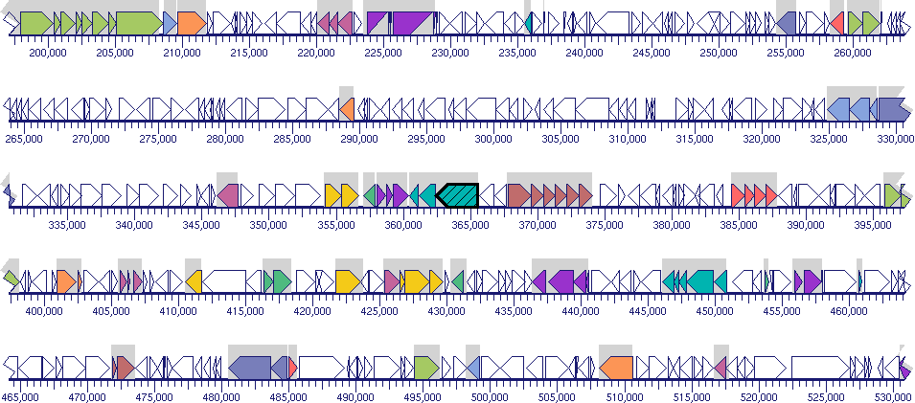
Prokaryotes (bacteria) have compact, gene-dense genomes. Below is a map of part of the E. coli genome.
The pointed boxes, white and colored, represent the protein coding regions of genes. Map is from EcoCyc (http://ecocyc.org/)

Slide 16
Dot plots for sequence comparisons
“Dot” plots visualize sequence alignments by taking a small sub-sequence of size k (k-mer) of one sequence and placing a ‘dot’ wherever that k-mer occurs in the other sequence
If a k-mer occurs in more than one place, multiple dots will be plotted (see “TCGCTAGA” on right)
Dot plots can be used for any string comparisons, but particularity nucleotide and amino acid compositions
AGCTGCTGATCGCTAGACTCAGGTCCAGATGATCGCTAGATTTTTTTTT
AGCTGCTGATCGCTAGACTCAGGTCCAGATGATCGCTAGATTTTTTTTT

Slide 17
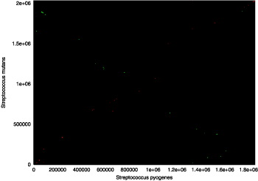
Whole genome DNA dot plot comparison of two Streptococcus species from the MUMmer3 Manual http://mummer.sourceforge.net/manual/#promer
DNA homology can be very low even between two bacterial species in the same genus; can't determine synteny by DNA comparison
This contrasts with mammals where synteny is clear across all species

Slide 18
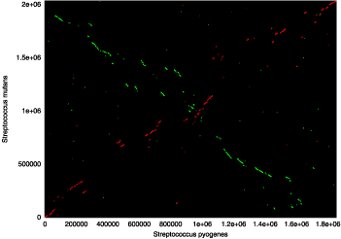
Comparison of the two Strep genomes at the protein level (six-frame translation of both genomes) – also using MUMmer Why are there 2 diagonals?

Slide 19
Note on MUMmer http://mummer.sourceforge.net/
Performs rapid alignments of DNA and protein
Whole genome alignments of prokaryote and fungal genomes
30 Mb fungal genome takes ~ 2 min forward and reverse (should be faster now on modern machines)
Can do complete mammalian chromosomes
Can align based on 6-frame translations
Uses suffix trees to perform the alignments – we will return to this later in the term when we consider sequence search and alignment algorithms

Slide 20
Bacterial DNA
Bacterial DNA is primarily contained in a single circular chromosome within a structure called the nucleoid.
Bacteria can also contain plasmids which are also circular but can be passed between individual bacterial cells through conjugation.
Both the bacterial chromosome and resident plasmids contain origins of replication, thus replicating themselves independently
Plasmids are an important tool for molecular biology as they can impart markers for experiments (e.g. antibiotic resistance).

Slide 21
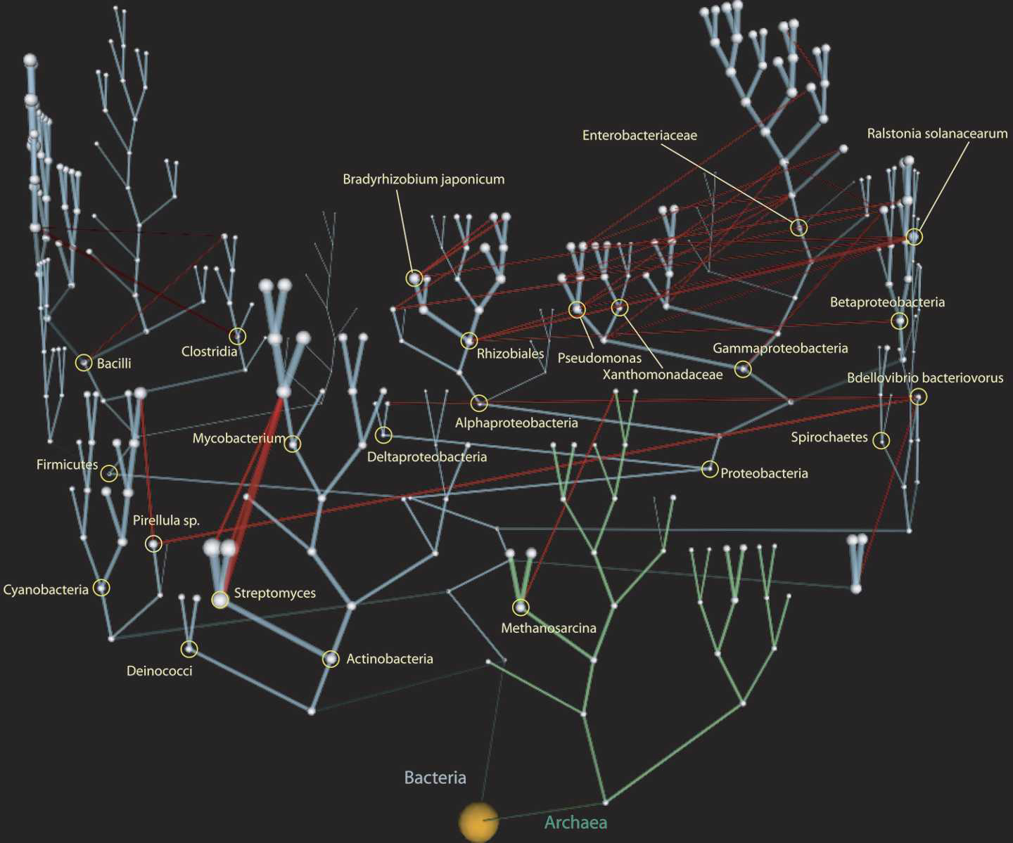
Horizontal gene transfer (HGT) is the transfer of DNA (specifically, genes) between bacterial species. It is very common in bacteria – red lines indicate HGT; Bacteria occupy a web, not a tree. HGT is one of the primary avenues by which antibiotic resistance can spread Vastly complicates the definition of species when genes are flowing so freely - not limited to lineal descent.
Horizontal Gene Transfer
Red lines indicate major paths of horizontal gene transfer
Kunin, et al., Genome Res. 2005 15: 954-959

Slide 22
Bacterial Gene Structure
Bacteria typically have multiple open read frames (ORFs) for each transcribed mRNA. Thus, they are polycistronic and make up operons.
Each ORF is translated independently using their own translational start sites (Ribosome Binding Site / Shine-Delgarno) and independent stop codons.
Both transcription and translation are done together as there is no need to transport mRNA to cytoplasm (as with Eukaryotes)

Slide 23
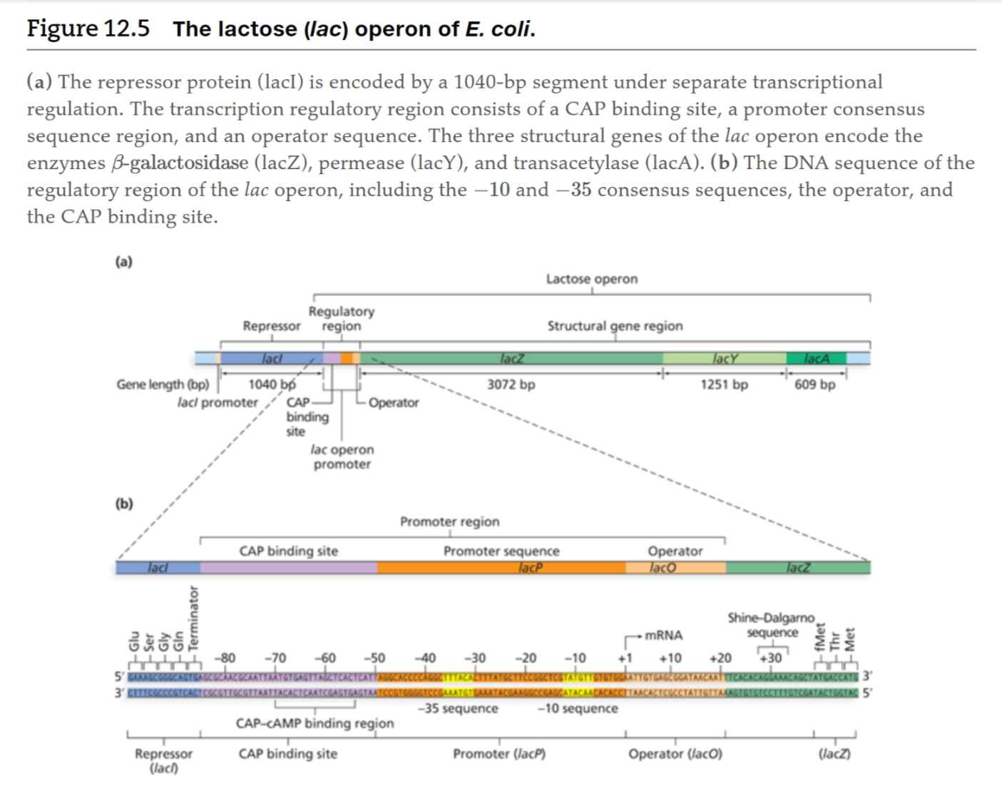
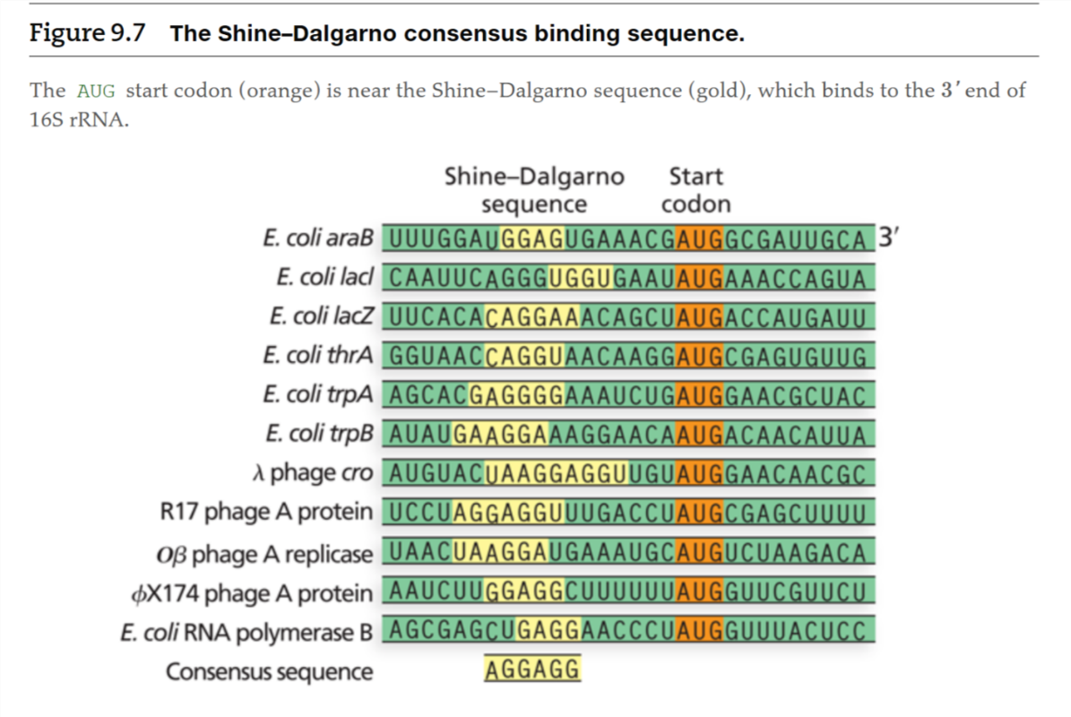
Example: lac operon
Sanders and Bowman. Genetic Analysis: An Integrated Approach. 2nd edition

